Slide 1
Sql vs Orm Queryset

Slide 2
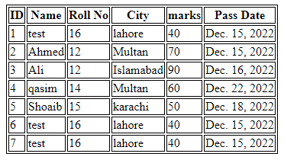
All queryset
SQL
SELECT * FROM Student;
ORM
Student .objects. all()
Result
Show All Table

Slide 3

Filter queryset
SQL
SELECT * FROM Student where marks=70;
ORM
Student .objects. filter(marks=70)
Result
It is used to extract only those
records that fulfill a specified condition.

Slide 4
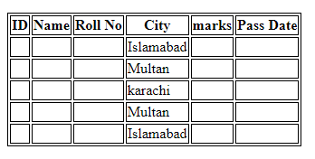
Distinct queryset
SQL
SELECT city FROM Student;
ORM
Student.objects.values(‘city’).distinct()
Result
The Distinct statement is used to return only distinct
(different) values.

Slide 5
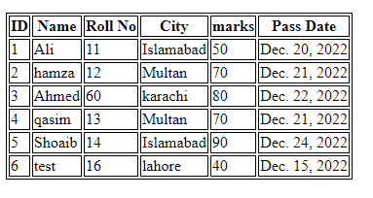
Create queryset
SQL
Create Table Student(id=‘6’, name=‘test’, roll_no=‘16’, city=‘lahore’, marks=‘40’, pass_date=‘2022-12-15’);
ORM
Student.objects.create(id=‘6’, name=‘test’, roll_no=‘16’, city=‘lahore’, marks=‘40’, pass_date=‘2022-12-15’)
Result
For get new column in the table

Slide 6
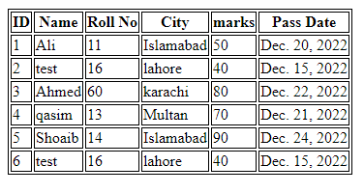
Update queryset
SQL
UPDATE Student SET name=‘test’, roll_no=‘16’, city=‘lahore’, marks=‘40’, pass_date=‘2022-12-15’ WHERE id=2;
ORM
Student.objects.filter(id=‘6’).update(name=‘test’, roll_no=‘16’, city=‘lahore’, marks=‘40’, pass_date=‘2022-12-15’)
Result
For update a table column

Slide 7
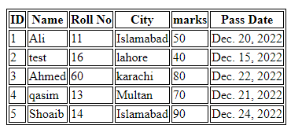
Delete queryset
SQL
DELETE FROM Student WHERE id=6;
ORM
Student.objects.filter(id=6).delete()
Result
For Delete a table column

Slide 8
Order_by queryset
SQL
SELECT * FROM Student ORDER BY id;
ORM
Student.objects.filter(‘id’).order_by(asc/dec)
Result
The order by command is used to
sort the result set in ascending or descending order.

Slide 9
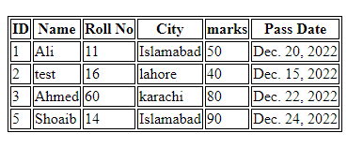
Exclude queryset
SQL
SELECT column from Student where not marks=70;
ORM
Student.objects.exclude(marks=70)
Result
Where condition match that not show
Further all shown in table.

Slide 10
Count queryset
SQL
SELECT COUNT (marks) FROM Student;
ORM
Average = Student.objects.aggregate(Count(‘marks’))
Result
In this query count the result in table.
{‘marks__count’: 5}

Slide 11
Max queryset
SQL
SELECT MAX (marks) FROM Student;
ORM
Average = Student.objects.aggregate(Max(‘marks’))
Result
In this query maximum result in table.
{‘marks__max’: 90}

Slide 12
Min queryset
SQL
SELECT MIN (marks) FROM Student;
ORM
Average = Student.objects.aggregate(Min(‘marks’))
Result
In this query minimum result in table.
{‘marks__min’: 40}

Slide 13
Average queryset
SQL
SELECT AVG (marks) FROM Student;
ORM
Average = Student.objects.aggregate(Avg(‘marks’))
Result
In this query Average the result in table.
{‘marks__avg’: 66.0}

Slide 14
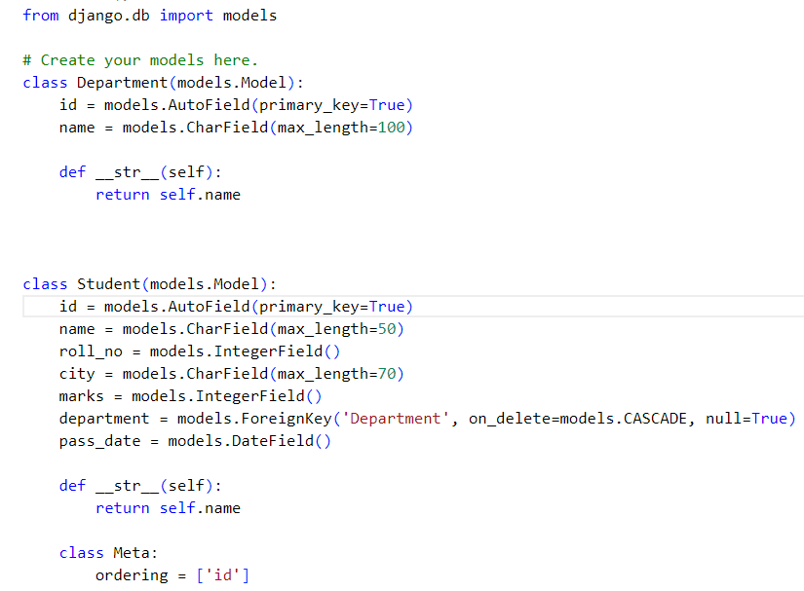
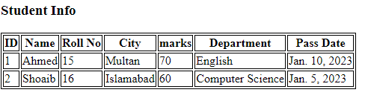
Attach Two tables by Foreign key:

